Slide 1
Workshop 1 – Intro: Anaconda, Jupyter, Pandas, Scikit-Learn
Advanced Analytics and Applications [AAA]
Information Systems for Sustainable Society (is3) | WiSo Faculty | Univ.-Prof. Dr. Wolfgang Ketter | 4/8/20

Slide 2
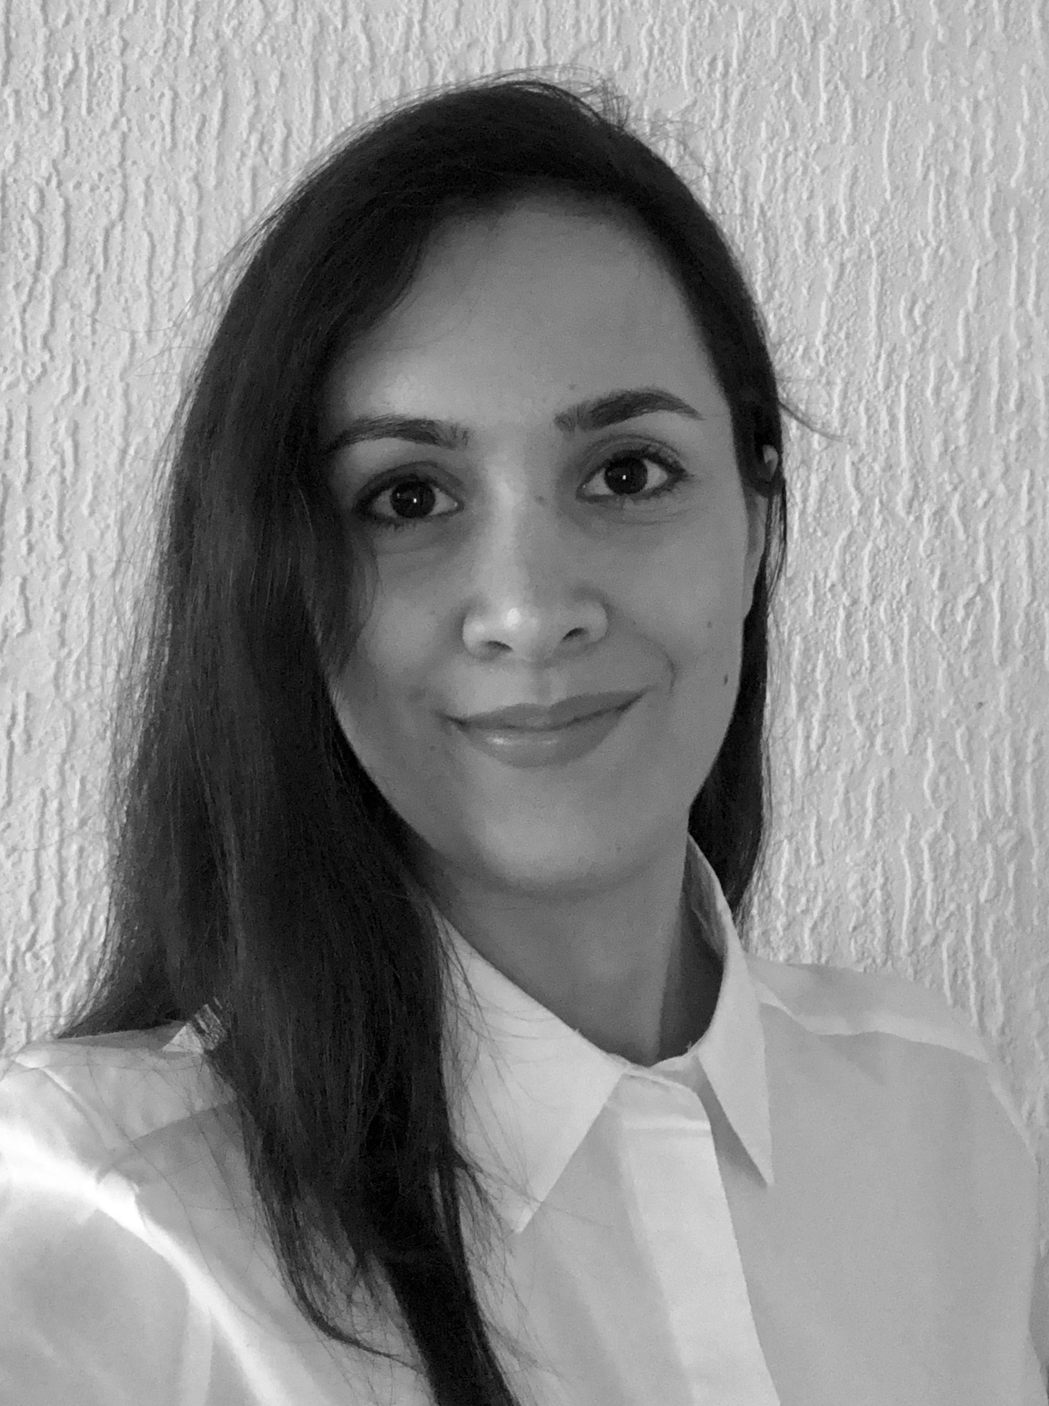
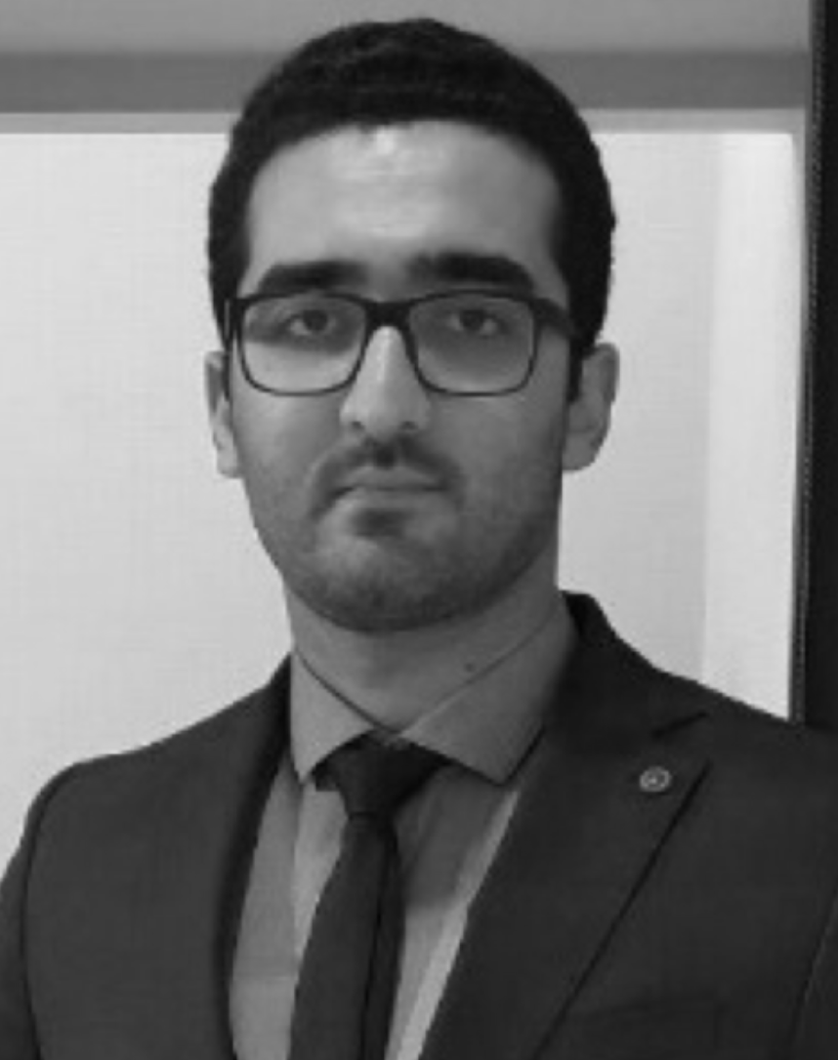
General Information
Teaching Assistants & Supporters
Nastaran Naseri
Doctoral Researcher
Ramin
Ahadi
(External) Doctoral
Researcher
B.Sc. And M.Sc. In Industrial Engineering from Ferdowsi University, Iran
Two years experience in discrete event simulation and game design for educational purpose
Research interest in analytical solution and market design for implementation of flexibility and storage in electricity markets
B.Sc. and M.Sc. in Mechanical Engineering and Industrial Engineering from Ferdowsi University.
After his studies, he worked as a researcher and a supervisor of Master students in SPOM Lab at Ferdowsi University.
Research interest in smart charging, e-mobility, autonomous vehicles, grid integration.

Slide 3

General Information
Teaching Assistant: Feel free to ask any question – we should embrace a “blame-free culture“.
Muhammed Demircan, B. Sc. In (Econo)-Mathematics and Information Systems; M. Sc. In (Econo-)Mathematics
first year PhD student – started my PhD studies last year (July 01, 2019)
Research interest: Smart Sustainable Mobility, Free-Floating Mobility (e.g., Car2Go, Lime etc.), Machine Learning, Statistics...
E-Mail: demircan@wiso.uni-koeln.de
LinkedIn: Muhammed Demircan
Twitter: it_demircan
Instagram: Good luck finding me.

Slide 4
General Information
GitHub: Workshop material will be uploaded to GitHub
https://github.com/IS3UniCologne/Advanced_Analytics_And_Applications_2020

Slide 5
I
Tools: Python, Anaconda, Jupyter Notebooks
II
Libaries: Numpy, Pandas and Scikit-Learn

Slide 6
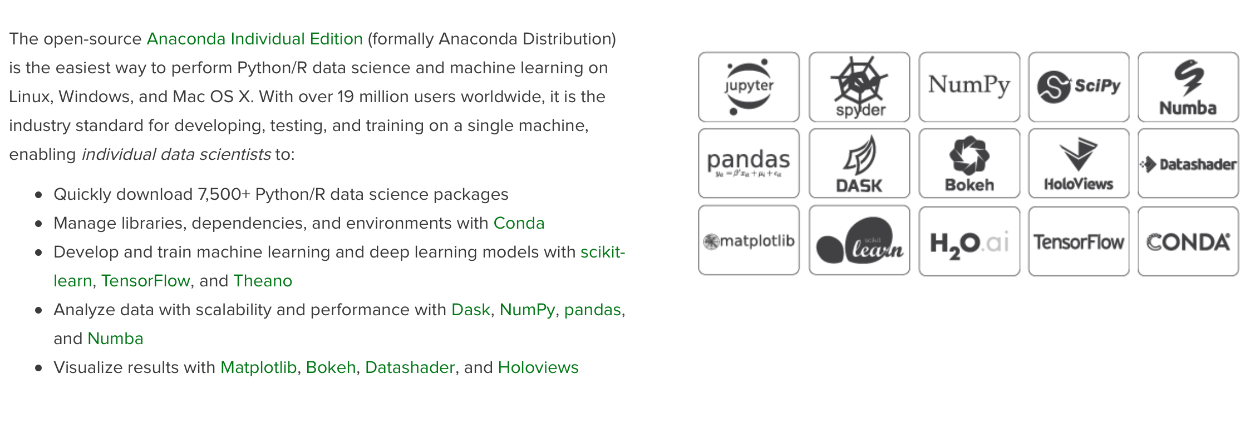
Tools
Anaconda: Why Anaconda?
Source: https://www.anaconda.com/distribution/

Slide 7
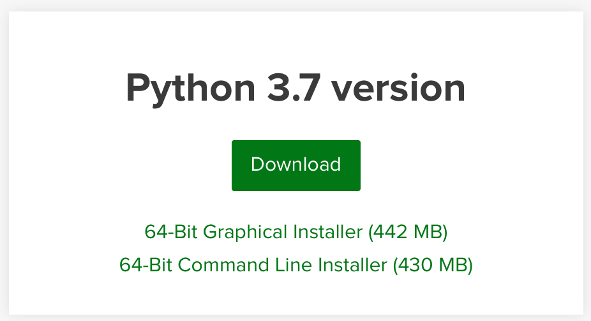
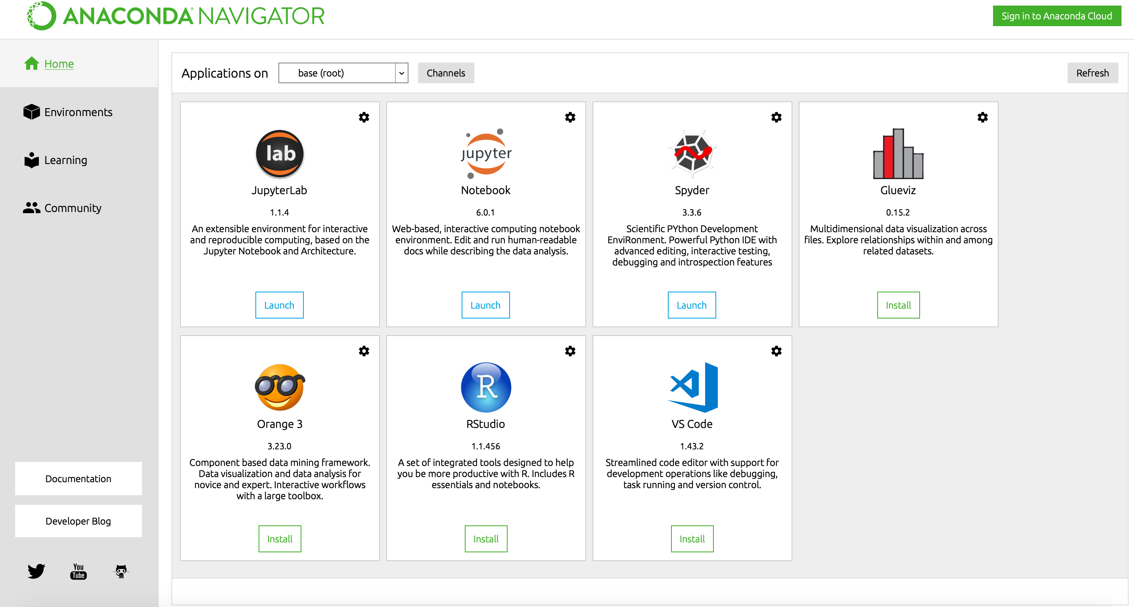
Tools
Anaconda: Installation
1
Download Link– https://www.anaconda.com/distribution/
2
Python Version – 3.7
3
Install on your device – If you have enough space, select all packages and libraries.
4
Start Anaconda-Navigator – If the installation process was successful, you should be able to start “Anaconda Navigator” now.

Slide 8
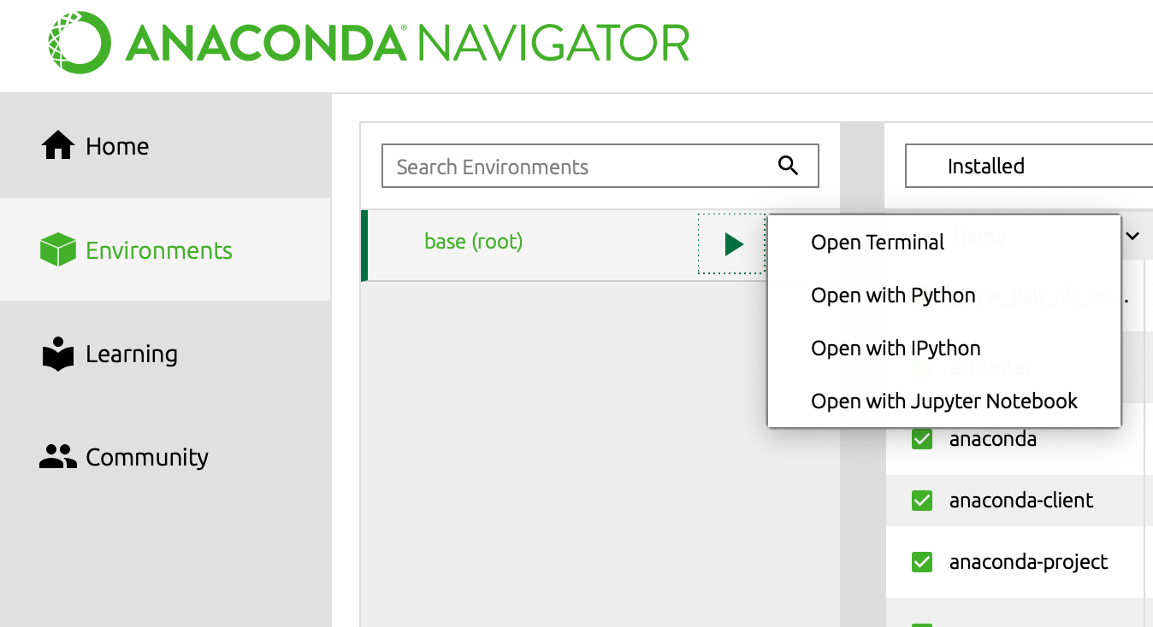
Tools
Jupyter Notebook: Starting a Notebook
1
2
3

Slide 9
I
Tools: Python, Anaconda, Jupyter Notebooks
II
Libaries: Numpy, Pandas and Scikit-Learn

Slide 10
Libraries
Pandas: A Data Scientist's favourite
This is not a tutorial on Python! We expect from you that you are familiar with the fundamentals of Python or at least are willing to learn it by yourselves.
Source: https://www.anaconda.com/distribution/

Slide 11
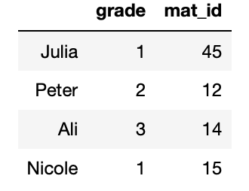
Requirements
Pandas: A Data Scientist's favourite
Main intended use: Read, clean, transform, write and analyze Data
Pandas is built on top of NumPy, and it can seamlessly work with different well-known Data–Science libraries such as SciPy, Matplotlib and Scikit-Learn.
Core concept of Pandas: Series and DataFrame:
Data Frame
Series
Series

Slide 12
Contact
For general questions and enquiries on research, teaching, job openings and new projects refer to our website at www.is3.uni-koeln.de
For specific enquiries regarding this course contact us by sending an email to the IS3 teaching address at is3-teaching@wiso.uni-koeln.de

